Slide 1
Battle of Neighbourhoods in Toronto
By Zequn Wang

Slide 2
Introduction
The city of Toronto is one of the largest and most populated multicultural metropolises in North America. Where there are people, there are needs for gourmet food. Toronto is no different.
By comparing 140 neighbourhoods by their current types of restaurants, this presentation will discuss how location influences food characteristics across the city.
The discussions could serve as a solid reference to business developers or restaurant owners who are looking forward to opening a new restaurant in Toronto.

Slide 3
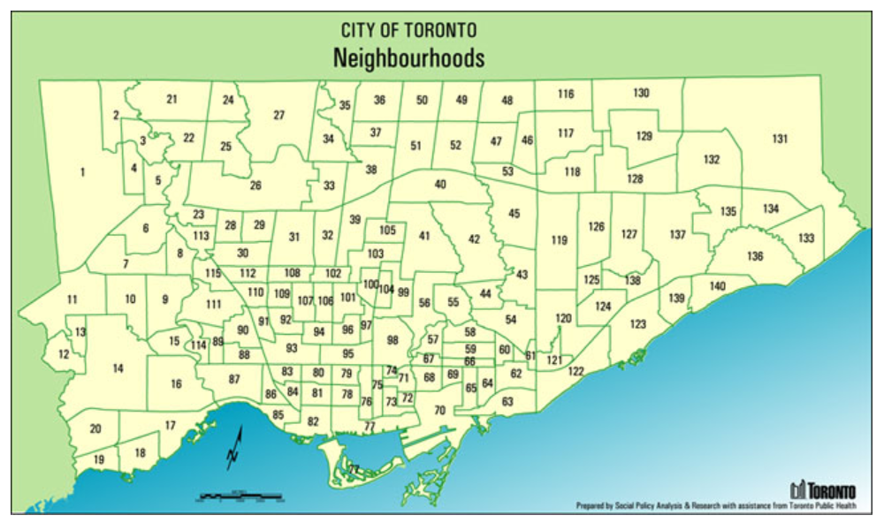
https://www.toronto.ca/city-government/data-research-maps/neighbourhoods-communities/neighbourhood-profiles/)

Slide 4
Data description
City of Toronto Open Data Portal:
• List of Neighbourhoods in Toronto and Codes
• Population in 2016
• Average individual income in 2015
• Geometry coordinates of each neighbourhood
Foursquare API Services:
• List of food venues around centroid of each neighbourhood
• Venue category
• Geometry coordinates of each venue

Slide 5
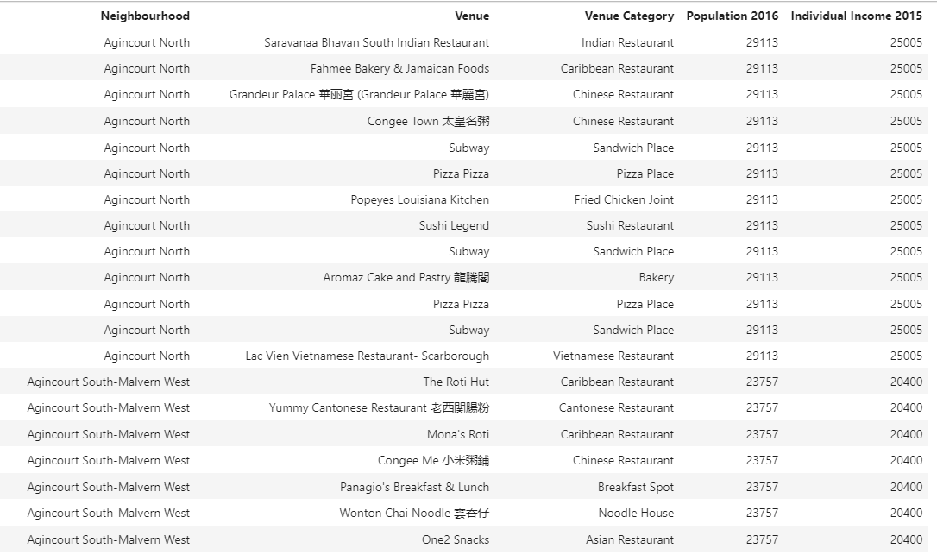

Slide 6
METHEDOLOGY
Based on available data, we ought to compare neighbourhoods by their demand for restaurants and the current level of competition.
Aggregate food venues (i.e., restaurants) for each neighbourhood
Cluster 140 neighbourhoods into five groups based on the category and frequency of different food venues located within the boundary of each neighbourhood.
Investigate the clustering of neighbourhoods based on food venues against population, individual income, and population income (individual income multiplied by population).
Identify neighbourhoods that have potential for opening more restaurants.

Slide 7
METHEDOLOGY
The clustering of neighbourhoods based on food venues will be accomplished using k-Means algorithm.
Another measure in additional to population and income is employed called population income, which is equal the multiplication of income by population. This metric can be interpreted as the accumulated annual income of a neighbourhood determined by both population and individual income. It incorporates population and individual income into one factor to evaluate different clusters of neighbourhoods.

Slide 8
RESULTs & Discussion Based on the categories of food venues, the 140 neighbourhoods are grouped into five clusters using k-Means method.
Cluster | No. of Neighbourhoods | Average no. of venues per neighbourhood | The first popular venue | The second popular venue
0 | 99 | 12 | Pizza Place | Pizza Place
1 | 38 | 46 | Restaurant | Sandwich Place
2 | 1 | 67 | Café | Vegetarian / Vegan Restaurant
3 | 1 | 59 | Bakery | Café
4 | 1 | 57 | Pizza Place | Italian Restaurant

Slide 9
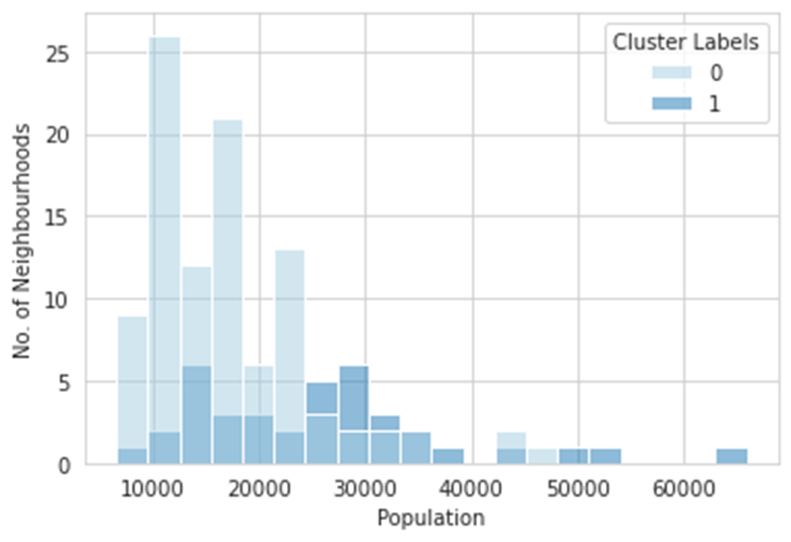
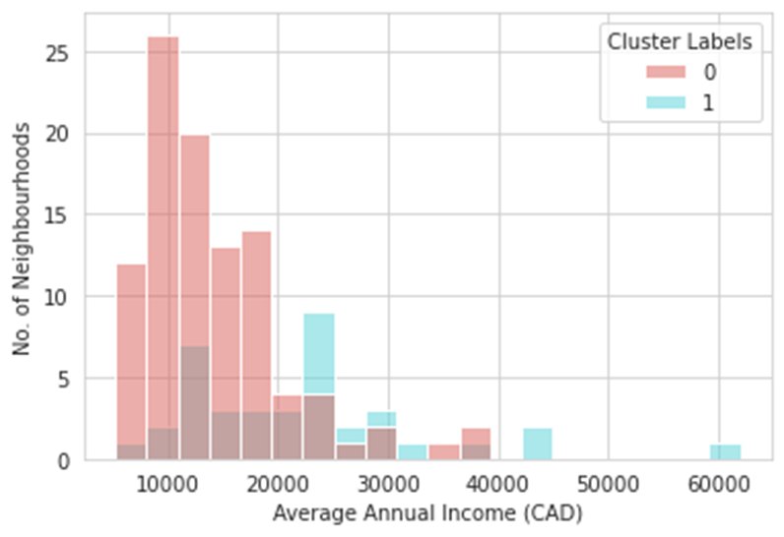
RESULTs & Discussion
Number of neighbourhoods in cluster 0 and 1 against neighbourhood population
Number of neighbourhoods in cluster 0 and 1 against neighbourhood individual income

Slide 10
RESULTs & Discussion
Cluster 0 is most popularized with pizza places while Cluster 1 has more mixed type restaurants and sandwich places. Also, cluster 1 has more restaurants than cluster 0 on average per neighbourhood.
When plotting the number of neighbourhoods in each of these two clusters against population and individual income, cluster 0 peaks at neighbourhoods with relatively low population and low income while cluster 1 has more neighbourhood of medium population and income.
First, cluster 1 represents neighbourhoods with more restaurants than cluster 0, which can be explained by the fact that neighbourhoods in cluster 1 have more population and higher income than those in cluster 0. Second, cluster 0 neighbourhoods are popularized with food venues like pizza places which are more affordable than the most popular food venues in cluster 1 neighbourhoods (mixed type restaurants).

Slide 11
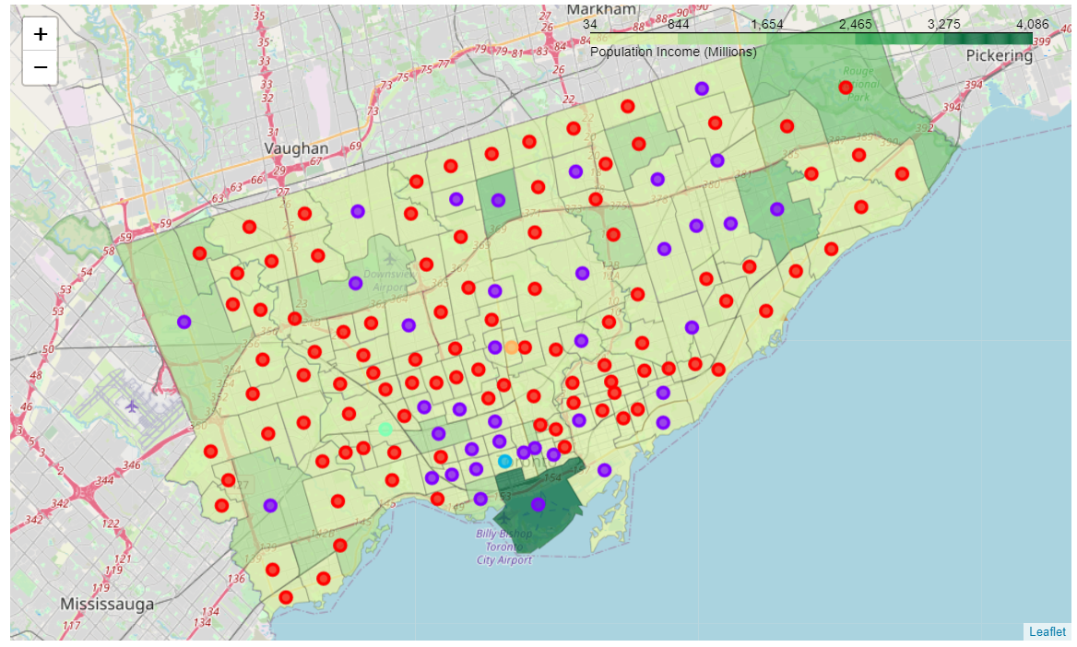
Clusters
 | 0
 | 1
 | 2
 | 3
 | 4

Slide 12
Conclusion
This article has compared 140 neighbourhoods in Toronto and explore their chances of opening a generic restaurant. Two data sources (City of Toronto Open Data Portal and Foursquare Location API Services) are used in retrieving location, population, and income information and different food venues in each of the neighbourhoods. Based on the categories of food venues (i.e., restaurants), the neighbourhoods are grouped into five clusters with two main clusters that are studied further.
It is noticed that cluster 0, corresponding to neighbourhoods with relatively low population and income, has a smaller number of food venues per neighbourhood and the venues are mostly affordable restaurants like pizza places. In comparison, cluster 1 neighbourhoods have more food venues and popularized with mixed type restaurants. Cluster 1 corresponds to medium to high population and income neighbourhoods.

Slide 13
Conclusion
As such, the best restaurant business opportunities should occur in cluster 0 neighbourhoods with high population/income or cluster 1 neighbourhoods with low population/income. For cluster 0 neighbourhoods with high population/income, the investors should consider opening medium to high end restaurants. For cluster 1 neighbourhoods with low population/income, the investors should consider affordable food chains such as pizza places.

Slide 14
Thank you
Zequn Wang

